Slide 1
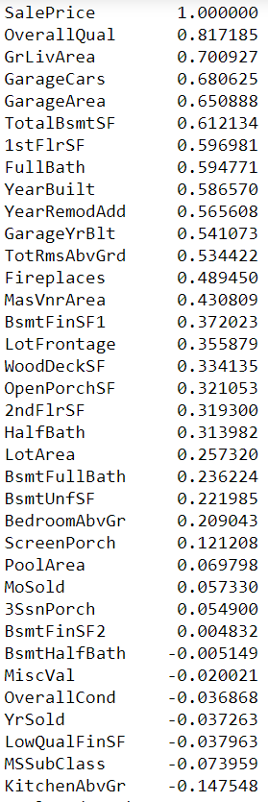
Data Exploration, Cleaning, Transformation and Engineering
Task:
Understand correlation and multicollinearity
02
Solution 1:
Calculate correlation between Sales Price and variables

Slide 2
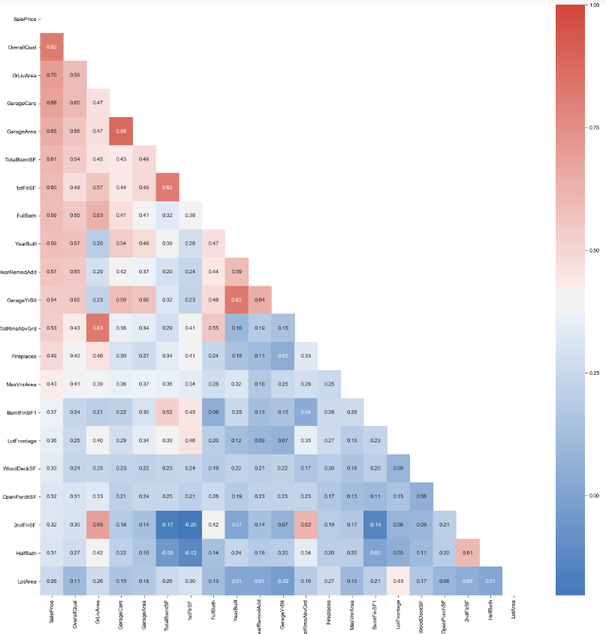
Data Exploration, Cleaning, Transformation and Engineering
Task:
Understand correlation and multicollinearity
02
Solution 2:
Correlation heatmap

Slide 3
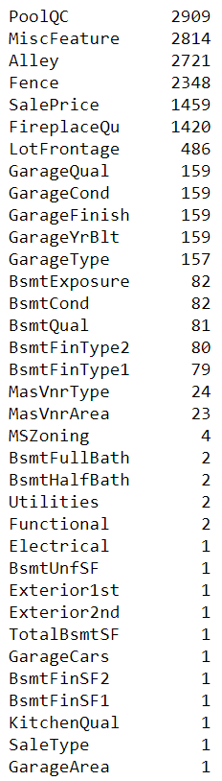
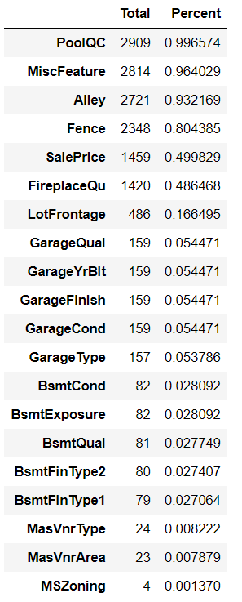
Data Exploration, Cleaning, Transformation and Engineering
Issue:
Lots of missing values
03

Slide 4
Data Exploration, Cleaning, Transformation and Engineering
Issue:
Lots of missing values
Solution:
Identify the reason for missing
Fill in missing values to the best judgments
03
NaN = None (categorical)
NaN = Assume it is typical
Still missing?
Based on data description, NaN actually means there is none (or 0). Fill in NaNs with None.
Example variable(s):
'GarageType', 'GarageFinish', 'GarageQual', 'GarageCond','BsmtQual’, 'BsmtCond', 'BsmtExposure', 'BsmtFinType1’ etc.
Based on data description, NaN actually means it belongs to the category “typical”.
Example variable(s):
‘Functional’
Observe how many NaNs are there
Luckily, there are very few missing (<5%) for each of the variables that still have missing values.
We filled in by taking the most common value.
Example variable(s):
'Exterior1st','Exterior2nd','SaleType','Electrical','KitchenQual’
NaN = 0 (numerical)
We can impute from existing data
Based on data description, NaN actually means there is none (or 0). Fill in NaNs with 0.
Example variable(s):
'GarageYrBlt’,'GarageArea’,'GarageCars','MasVnrArea','BsmtFinSF1','BsmtFinSF2','BsmtFullBath','BsmtHalfBath','FullBath','HalfBath’ etc.
‘LotFrontage’ is dependent on the zoning district in which a property is located (i.e. ‘Neighborhood’)
Group by neighborhood & LotArea and fill in missing value by the median LotFrontage of each neighborhood.
Example variable(s):
‘LotFrontage’
Result:
No missing values now!

Slide 5
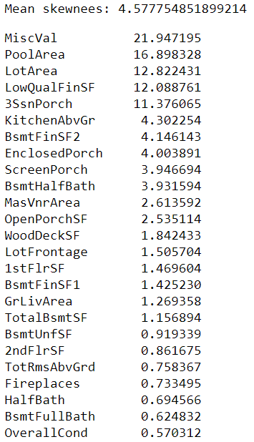
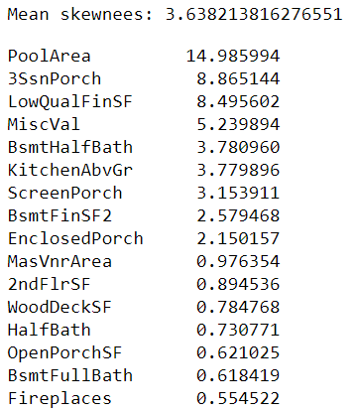
Data Exploration, Cleaning, Transformation and Engineering
Issue:
Some numerical variables are highly skewed
Solution:
Box Cox transformation
04
Check for numerical features where
skewness is > 0.5
abs(skewness)>1： highly skewed
1 > abs(skewness) > 0.5： moderately skewed
Taking conservative approach and adjusting for
moderately skewed
16 highly-moderately skewed numerical variables
25 highly-moderately skewed numerical variables

Slide 6
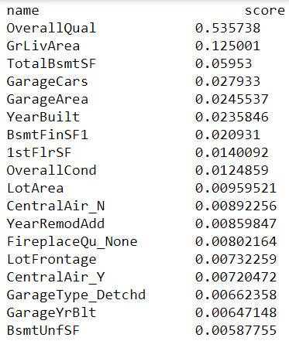
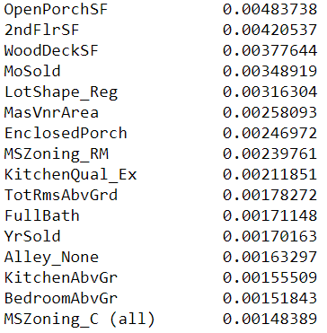
Data Exploration, Cleaning, Transformation and Engineering
Task
Understand feature importance
05
Solution:
Run RF algorithm and observe feature importance

Slide 7
Data Exploration, Cleaning, Transformation and Engineering
Task:
Data engineering
We see high correlations between variables that are related to areas/SF
Solution:
Combining relevant area/SF related variables into new variables.
06
‘TotalBsmtSF’ ‘1stFlrSF’ ‘2ndFlrSF’
‘Total SF’
‘FullBath’ ‘HalfBath’ * 0.5 ‘BsmtFullBath’ ‘BsmtHalfBath’*0.5
‘Total Bathrooms’
‘OpenPorchSF’ ‘3SsnPorch’ ‘EnclosedPorch’ ‘ScreenPorch’ ‘WoodDeckSF’
‘Total Porch’

Slide 8
Data is cooked and ready!
Let the modeling begin…

Slide 9
Agenda
01
Background
Origin of dataset, categorical vs. numerical variables, objective
02
Data Exploration, Cleaning, and Transformation
Missing values, skewness, multicollinearity, feature importance
03
Predictive Models
Ridge, Lasso, ElasticNet, LightGBM, XGBoost, GDBoost, Random Forest
04
Results and Conclusion
Stacking models, Kaggle results, Thoughts, and Q&A

Slide 10
Machine Learning Models Used:
Ridge
Lasso
Elastic Net
01
Regularized linear regression
02
Regularized linear regression
Allows feature selection
Regularized linear regression
Hybrid of Ridge & Lasso
03
Gradient Boosting (GBDT)
XGBoost
LightGBM
Ensemble method
Add prediction of multiple decision trees together
Loss function is minimized by each split
A subtype of GBDT
Leaf-wise growth strategy
Pre-sorted algorithm & histogram-based algorithm to find best split.
Needs label encoding for categorical variables
A subtype of GBDT
Leaf-wise growth strategy
Gradient-based one-side sampling to find best split
Does not need label encoding for categorical variables
04
05
06
Random Forest
07
Ensemble method
Predict by averaging over the predictions of all decision trees

Slide 11
Machine Learning Models Used:
 | Reg Regression Auto Param |  |  | Param Fine Tuning
 | Mean CV RMSE | Model score | RMSE | Mean CV score | Model score | RMSE
Ridge | 0.1080 | 0.9456 | 0.09319 | 0.1080 | 0.9440 | 0.094511
Lasso | 0.1116 | 0.9295 | 0.1061 | 0.1067 | 0.9405 | 0.09742
ElasticNet | 0.1116 | 0.9295 | 0.10611 | 0.1067 | 0.9405 | 0.09742
Gradient Boosting | 0.1143 | 0.9843å | 0.05008 | 0.1143 | 0.9741 | 0.05008
XGBoost | 0.1117 | 0.9846 | 0.04951 | 0.1117 | 0.9846 | 0.04952
LightGBM | 0.1128 | 0.9741 | 0.06428 | 0.1129 | 0.9842 | 0.0648
Random Forest | 0.1415 | 0.9762 | 0.06159 | 0.1457 | 0.9764 | 0.06139
Notes:
Results similar – decided to use fine tuning
Results for Lasso and ElasticNet are the same,
So thought of removing ElasticNet

Slide 12
Experiment
Approach | Stack RMSE
StakingRegressorCV With Elastic Net | 0.07481
StakingRegressorCV Without elastic net | 0.0685
Averaging Predictions With Elastic Net | 0.06716
Averaging Predictions Without Elastic Net | 0.06263
Weighing by inverse RMSE With Elastic Net | 0.0666
Weighing by inverse RMSE Without Elastic Net | 0.06218

Slide 13
Two outliers removed (sal– extremely overfit
Lower prediction (Kaggle score)

Slide 14
Machine Learning Models Used:
Standardized
 | Reg Regression Auto Param |  |  | Param Fine Tuning
 | Mean CV RMSE | Model score | RMSE | Mean CV score | Model score | RMSE
Ridge | 0.1080 | 0.9456 | 0.09319 | 0.1080 | 0.9440 | 0.094511
Lasso | 0.1116 | 0.9295 | 0.1061 | 0.1067 | 0.9405 | 0.09742
ElasticNet | 0.1116 | 0.9295 | 0.10611 | 0.1067 | 0.9405 | 0.09742
Gradient Boosting | 0.1143 | 0.9843 | 0.05008 | 0.1143 | 0.9741 | 0.05008
XGBoost | 0.1117 | 0.9846 | 0.04951 | 0.1117 | 0.9846 | 0.04952
LightGBM | 0.1128 | 0.9741 | 0.06428 | 0.1129 | 0.9842 | 0.0648
Random Forest | 0.1415 | 0.9762 | 0.06159 | 0.1457 | 0.9764 | 0.06139

Slide 15
Machine Learning Models Used:
 | Reg Regression Auto Param |  |  | Param Fine Tuning
 | Mean CV RMSE | Model score | RMSE | Mean CV score | Model score | RMSE
Ridge
Lasso
ElasticNet
Gradient Boosting
XGBoost
LightGBM
Random Forest
Results similar – decided to use fine tuning
Results for Lasso and ElasticNet are the same,
So thought of removing ElasticNet

Slide 16
Stack the models

Slide 17
Agenda
01
Background
Origin of dataset, categorical vs. numerical variables, objective
02
Data Exploration, Cleaning, and Transformation
Missing values, skewness, multicollinearity, feature importance
03
Predictive Models
Ridge, Lasso, ElasticNet, LightGBM, XGBoost, GDBoost, Random Forest
04
Results and Conclusion
Stacking models, Kaggle results, Thoughts, and Q&A

Slide 18
Results
Further Improvement Areas
Placed at # [XXX] (score XXX) on Kaggle as of July 28, 2019
Explore more on feature engineering / addition of more features
More time further tuning the hyperparameters
Attempts and Thoughts
We attempted to use random forest to impute missing values, but this did not improve our results. This is likely due to overfitting problem given our small data size.
Data engineering with new combined variables does not necessarily give us better prediction results.
Stacking models will almost always give better results than stand-alone models.
Machine learning requires lots of trials and errors at each step of the process.

Slide 19
Thank you!

